Slide 1
Routing and Wavelength (Spectrum) Assignment
Optical Communications Networks
Spring 2021

Slide 2
Routing and Wavelength (Spectrum) Assignment: Concepts
Allocating a route and wavelength (or spectrum slice) demands in a network
Effective use of both physical topology and traffic matrix
Considerations
Cost
Latency
Availability
Having impacts on congestion and total carried traffic

Slide 3
Terminology
Network nodes
Sites that source, terminate and switch traffic
Amplifier-only sites are NOT nodes!
Network links
Optical fibers running between two nodes
Almost always bidirectional with a separate fiber at each direction
Also referred to as “hops”
Network topology
Interconnection pattern of nodes
Nodal degree
Number of incident fiber-pairs at node
Optical reach
The distance that signal can traverse all-optically before requiring to be regenerated
Specially important in backbone networks

Slide 4
Terminology (cont’d)
Routing (R) and wavelength assignment (WA), together referred to as RWA
Regeneration
Entering the WDM signal from optical to electrical domain and again, to optical
3R regeneration
Re-amplification
Re-shaping
Re-timing
O-E-O architecture
Signal regeneration at each intermediate node
Large amount of equipment!
Drawbacks in terms of cost, power consumption, reliability and space requirements
O-O-O (all-optical) architecture
Signal being carried in optical domain throughout transmission
Also referring to infrequent regeneration
Reconfigurable optical add/drop multiplexers (ROADMs) for optical bypass

Slide 5
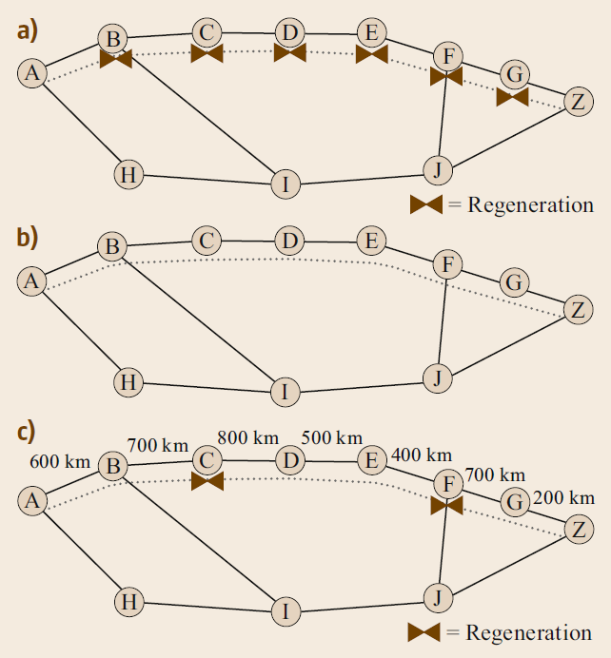
O-E-O vs. O-O-O architecture
A recent research area:
Investigating regenerations also in a point on links not only nodes
In a typical network, shortest path was not the minimum-regeneration path for 1% of demands!

Slide 6
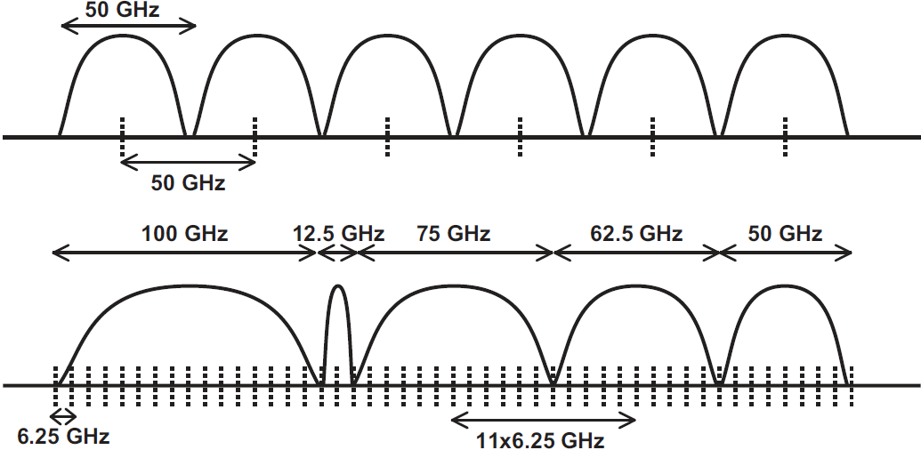
Wavelength- vs. Spectrum Assignment
Wavelength
Fixed griding
Sub-optimal due to fixed-grid constraints
Less contention-prone
Simple design
Spectrum
Flexible griding
More optimal
More contention-prone
More complicated design

Slide 7
RWA (RSA) Perspectives
WA (SA), O-O-O architecture
Challenging design
Wavelength continuity constraint
WA (SA), O-E-O architecture
Simple problem of WA
Routing order
Fulfilling more challenging demands first
Back-up paths for a connection
Multiple candidates for a connection
Routing strategies
Avoiding congestion
Shortest path
Minimum-hop
Wavelength contention
Free capacity, but no free wavelength due to poor design!
Heuristic algorithms
Joint routing and wavelength assignment
More complicated algorithm as opposed to separate RWA
Impairment-aware RWA
Exploiting models for capturing fiber impairments
Multicast routing

Slide 8
RWA (RSA) Perspectives (cont’d)
Wavelength contention
Free capacity, but no free wavelength due to poor design!
Heuristic algorithms
Joint routing and wavelength assignment
More complicated algorithm as opposed to separate RWA
Impairment-aware RWA
Exploiting models for capturing fiber impairments

Slide 9
Shortest-Path Routing Algorithms
Target
Finding a path of minimum total metric (whether distance, hop, etc.)
Assumptions
Additive cost
No negative cycles in network
(bidirectional links; indifference between source and destination)
Algorithms
Dijkstra
Minimum distance
Greedy
Always yielding a solution (if exists)
Breadth-first-search (BFS)
Minimum hop
Link cost equal to 1
Constrained shortest-path (CSP)
Extra constraints on paths found (e.g. maximum number of hops not exceeding a threshold)

Slide 10
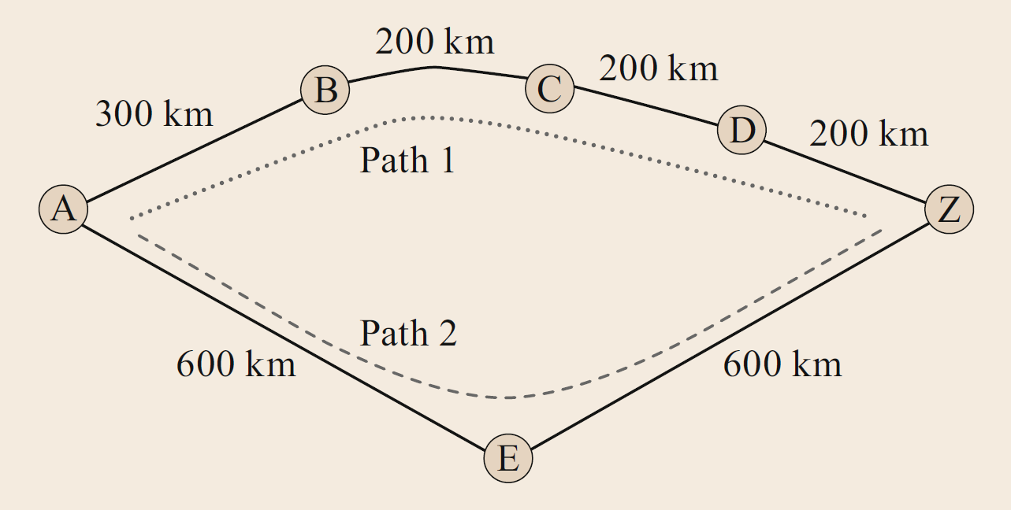
k-Shortest-Paths Routing Algorithms
Target
Generating a set of paths between source and destination
Path distances in ascending order from the shortest up to k-th shortest
Benefits
Better load balancing
Avoiding congestion
Paths may have common links!

Slide 11
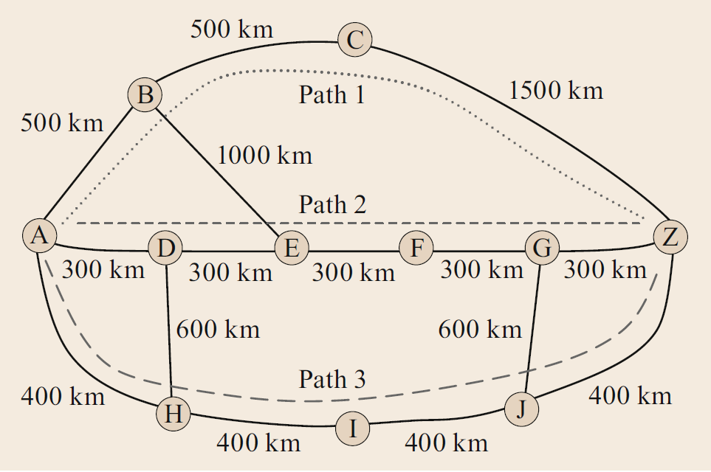
Shortest-Distance Versus Minimum-Hop Routing
O-E-O architecture
Cost equivalent to number of regenerations
Setting link metric equal to 1
Minimum-hop
O-O-O architecture
Not a straightforward choice of metric ☹
Running k-shortest-path algorithms twice (once with minimum-distance metric and again with unity metric) and finding the best path with minimum regeneration

Slide 12
Protection Considerations in Routing
Service-level agreement (SLA)
A formal contract between service costumer and service provider
Availability
Protection level against network failures
Disjoint-path routing for protection
Failure-dependent protection
Restoration of a service path around a detected failure location
Time-consuming!
Failure-independent protection
Setting up backup paths prior to possible failures
Typically link-disjoint
Also node-disjoint for important services

Slide 13
Methods for Finding Disjoint Paths
Method 1
Running a shortest-path algorithm and finding an optimal path
Removing the links of the path from network (topology pruning)
Running the shortest-path algorithm again and finding another optimal path
Returning the two results as final response
Method 2
Using an original (!) shortest pair of disjoint paths (SPDPs) algorithm
Minimal sum of link metrics over the resulting paths
More advanced topology pruning
Bhandari algorithm
Also applicable to finding more than two desired paths
Suurballe algorithm

Slide 14
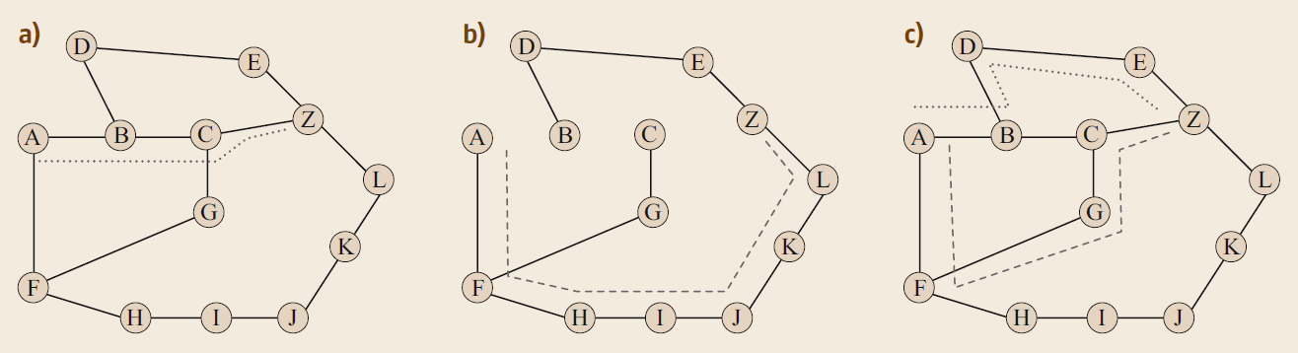
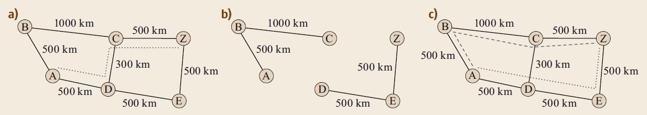
Drawbacks of Method 1
Suboptimal
Infeasible, trap topology

Slide 15
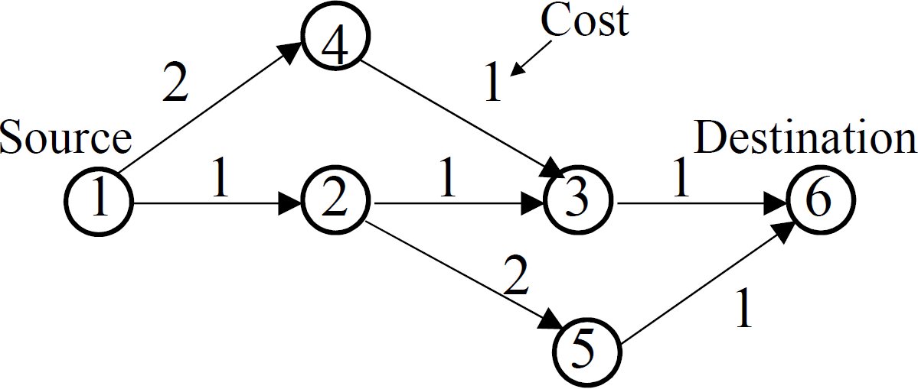
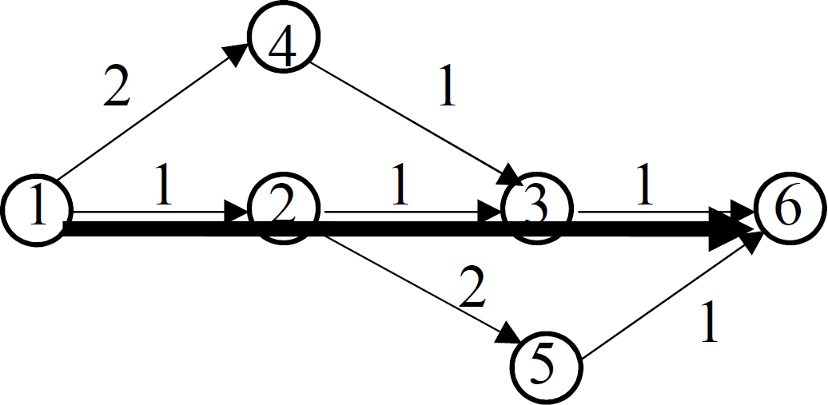
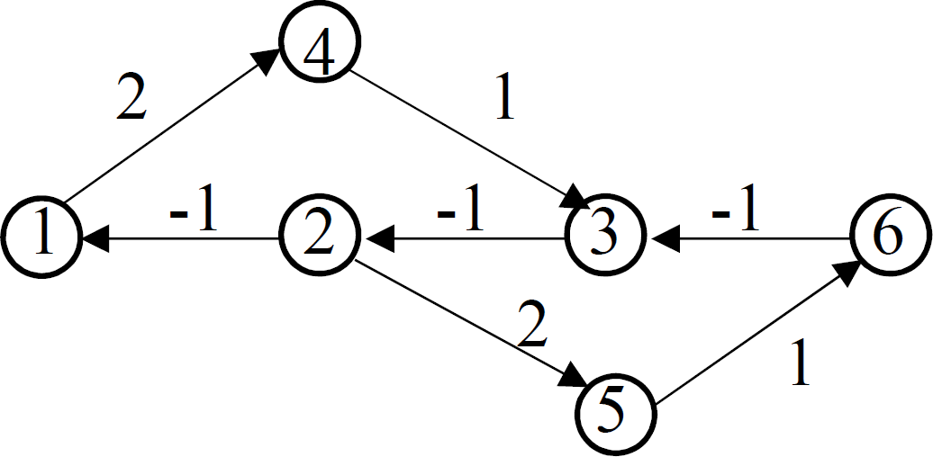
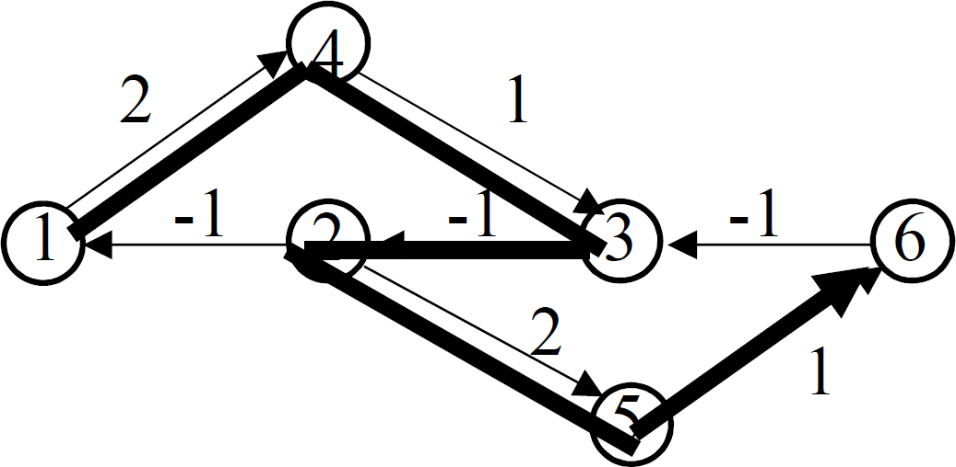
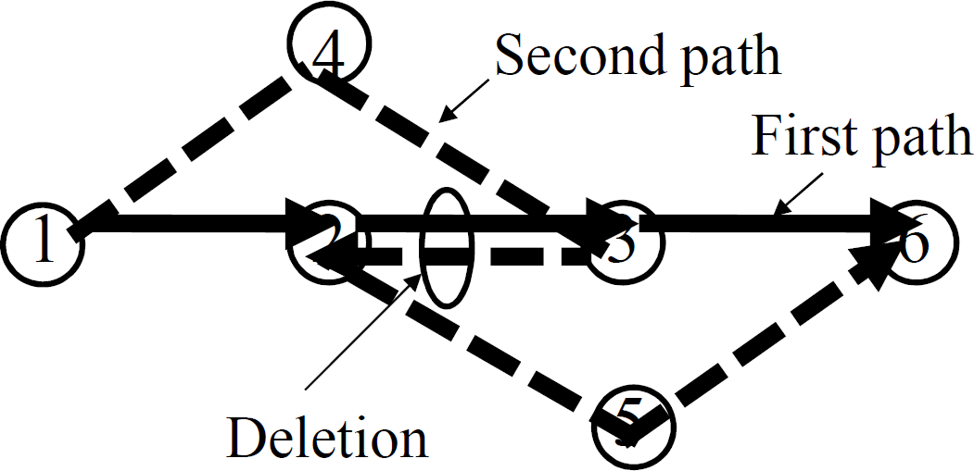
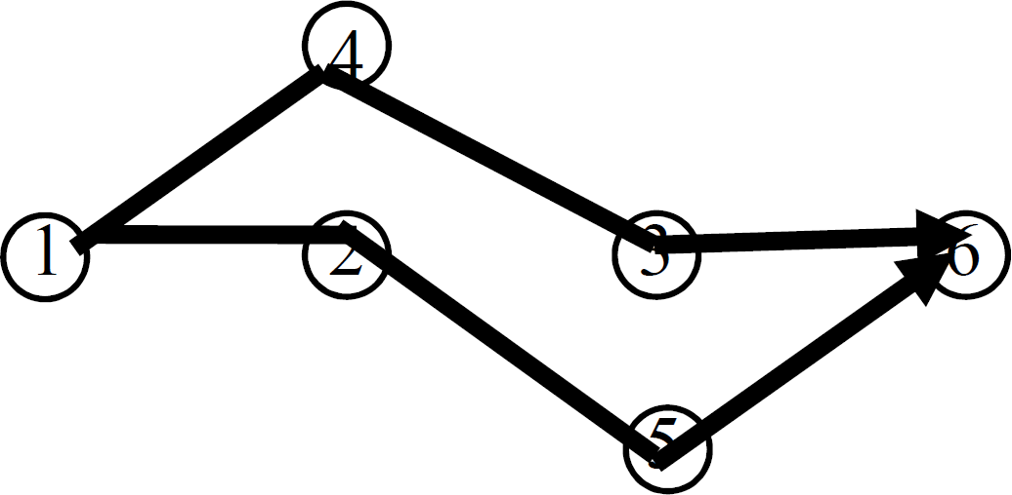
Method 2: Bhandari Algorithm

Slide 16
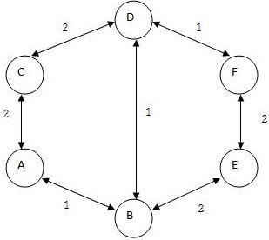
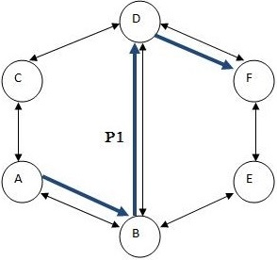
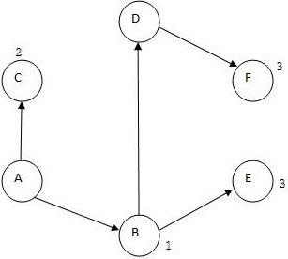
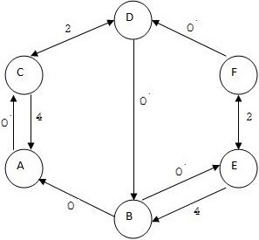
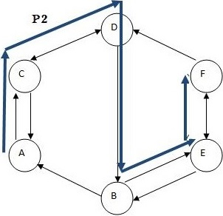
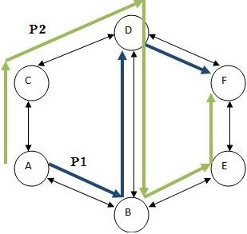
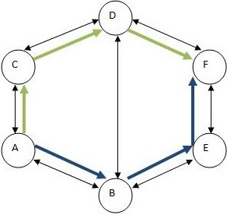
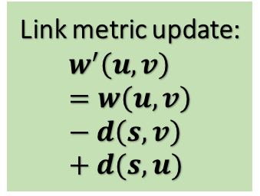
Method 2: Suurballe Algorithm
Link metric update:
$$w^{′}\left(u,v\right)=w\left(u,v\right)−d\left(s,v\right)+d(s,u)$$

Slide 17
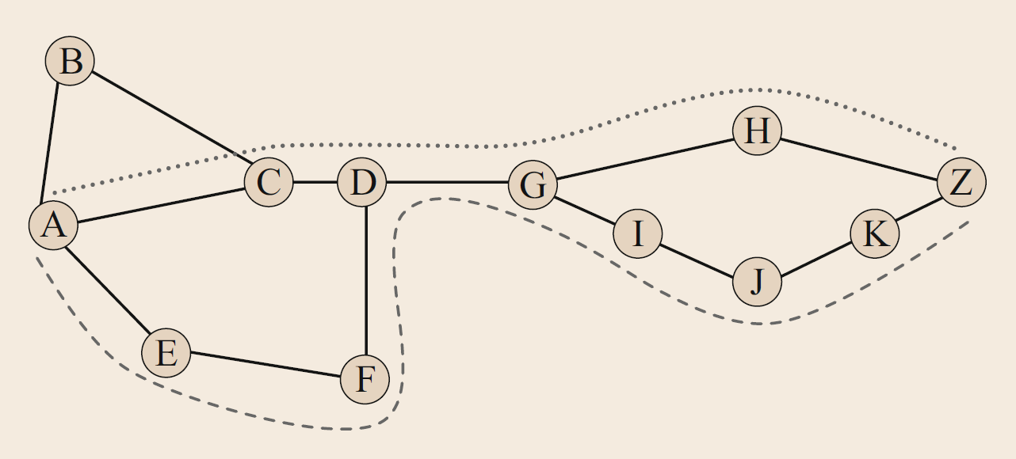
Scenarios with SPDP Algorithm Failure
Maximally disjoint paths

Slide 18
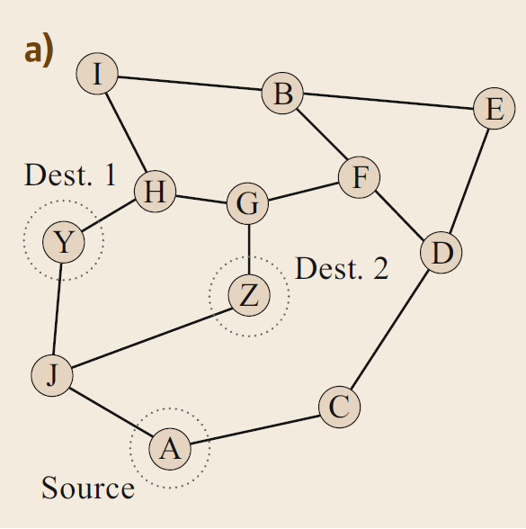
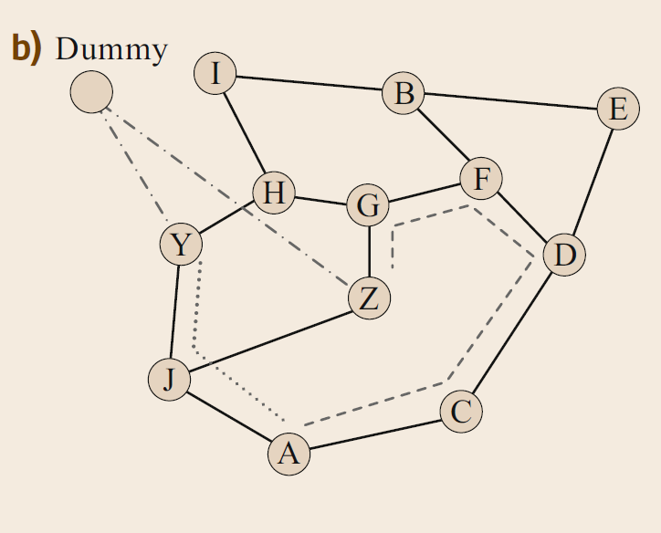
Disjoint-Path Routing with Multiple Sources and/or Destinations

Slide 19
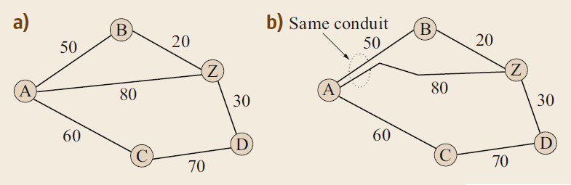
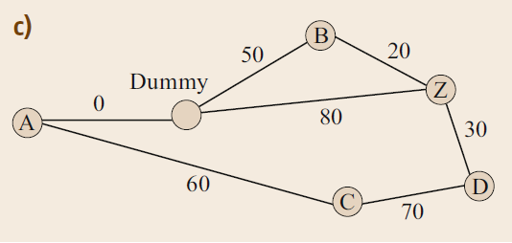
Shared-Risk Link Group (SRLG)

Slide 20
Routing Strategies
Fixed-path routing
Same path for all connection requests between source and destination
Blocking of new connections if links are congested
Simple
Non-adaptive
Optimal from latency point of view
Alternative-path routing
Many candidate paths for all connection requests between source and destination
Choosing path for connection requests based on current network load
Adaptive
More time-consuming

Slide 21
Routing Strategies (cont’d)
Pure dynamicity may be sub-optimal from the viewpoint of efficiently packing the wavebands.
Dynamic routing
No route pre-calculations, connection requests are processed once arrived!
Dynamic change of link metrics
Considerations
Cost
Load
Most opportunity for adaptation to current network state
Decision delay is a problem, specially in presence of a path-computation element (PCE).

Slide 22
Routing Order
Ordering priority
Whether or not a service requires protection
Whether or not a service must be routed over hot links
Service requested rate
Distance between endpoints
Ordering algorithm (stimulated annealing)
Finding a base result
Swapping two services’ priorities
Running the routing process again
Checking the result from optimality point of view
Update the result with a probability
Proceed these steps long enough

Slide 23
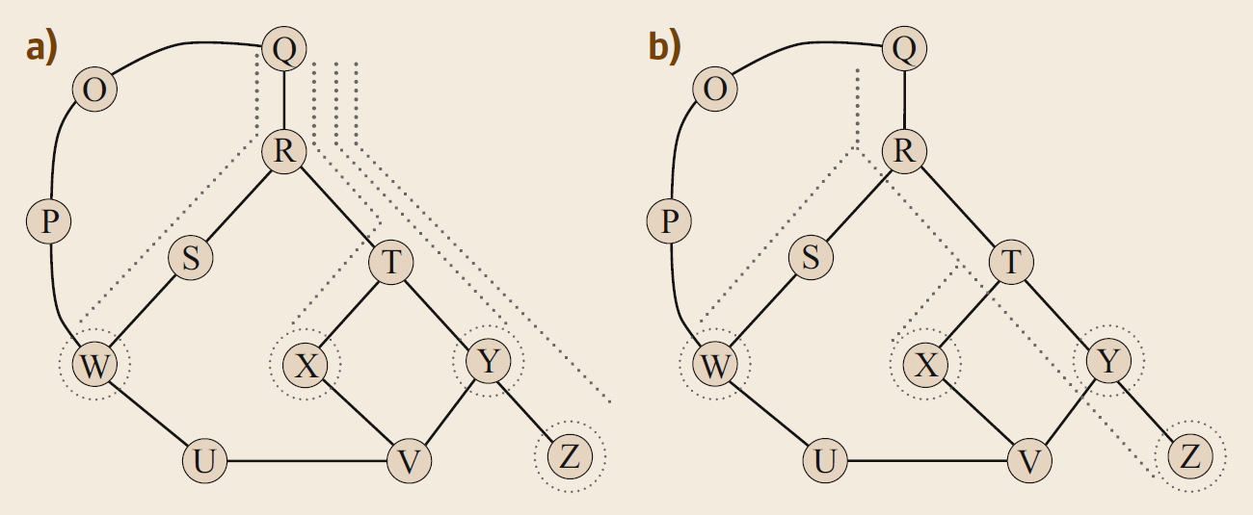
Multicast Routing
Multicast versus multiple unicasts
Saving capacity by a factor of 2 or 3

Slide 24
Multicast Routing
Usage
Media distribution
Multicast tree (Steiner tree)
Tree cost as the sum of its link metrics
Difficult problem of finding a minimum-cost Steiner tree
Heuristics with good, approximate solutions
Minimum-spanning tree with enhancement (MSTE)
Minimum-paths (MP)
Multicast protection
Large protection facilities!
Protection of tree segments
Network coding
Reception of a linear combination of signals rather at each destination
Manycast routing
Reaching N out of M destinations
Usage
Distributed computing
A variation of MP algorithm to obtain the optimum tree

Slide 25
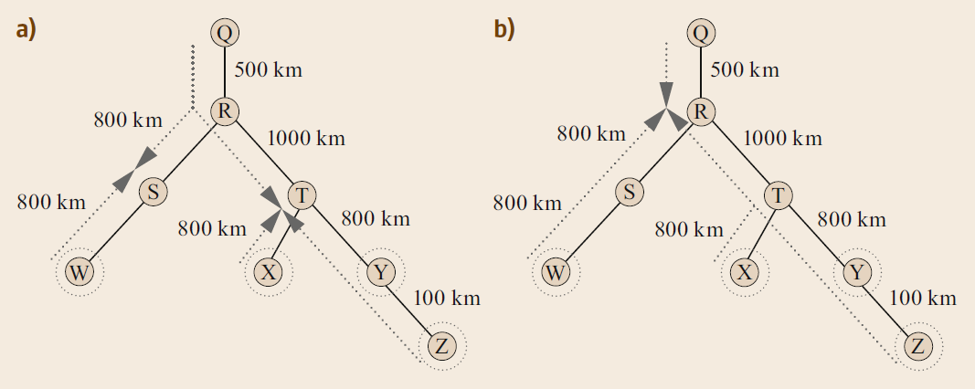
Multicast Protection with respect to Regeneration Sites

Slide 26
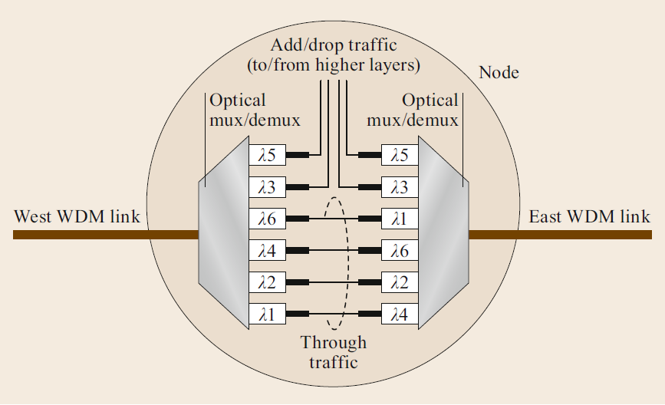
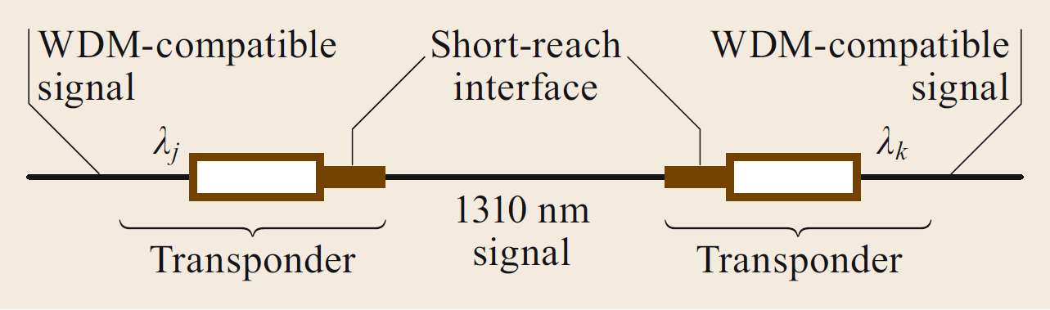
Wavelength Assignment
Allocating spectrum portions to routed connections
Also abbreviated to as WA
Cooperation with regeneration
Wavelength conversion
Back-2-back transponders

Slide 27
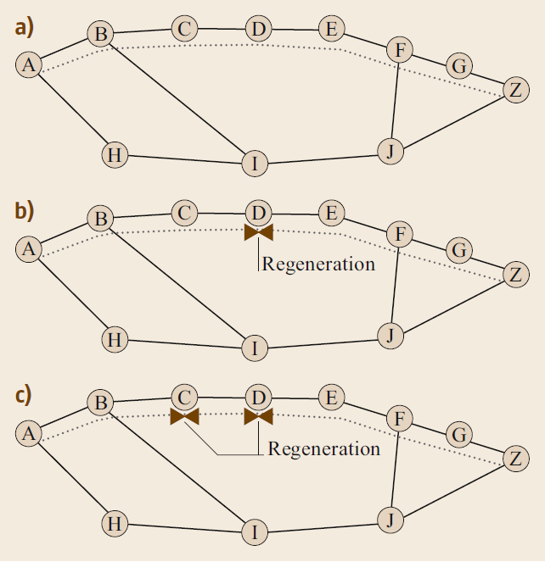
Wavelength Assignment; Challenges
Major challenges
Wavelength continuity in an optical segment of transmission
Link utilization
There is a trade-off between WA simplicity and cost in presence of regeneration!

Slide 28
Wavelength Assignment Failure
Four possible options
Blocking the service (!)
Changing the places of regeneration
Changing the route
Increasing the number of regenerations without re-routing
Greater cost

Slide 29
WA Studies; Figures of Merit
Sparse, but sufficient regeneration
Regenerations due to optical reach constraints in backbone networks are mostly enough!
In metro-core networks, regeneration may be offered by electrical-domain grooming.
Wavelength contention is a major cause of connection blocking.

Slide 30
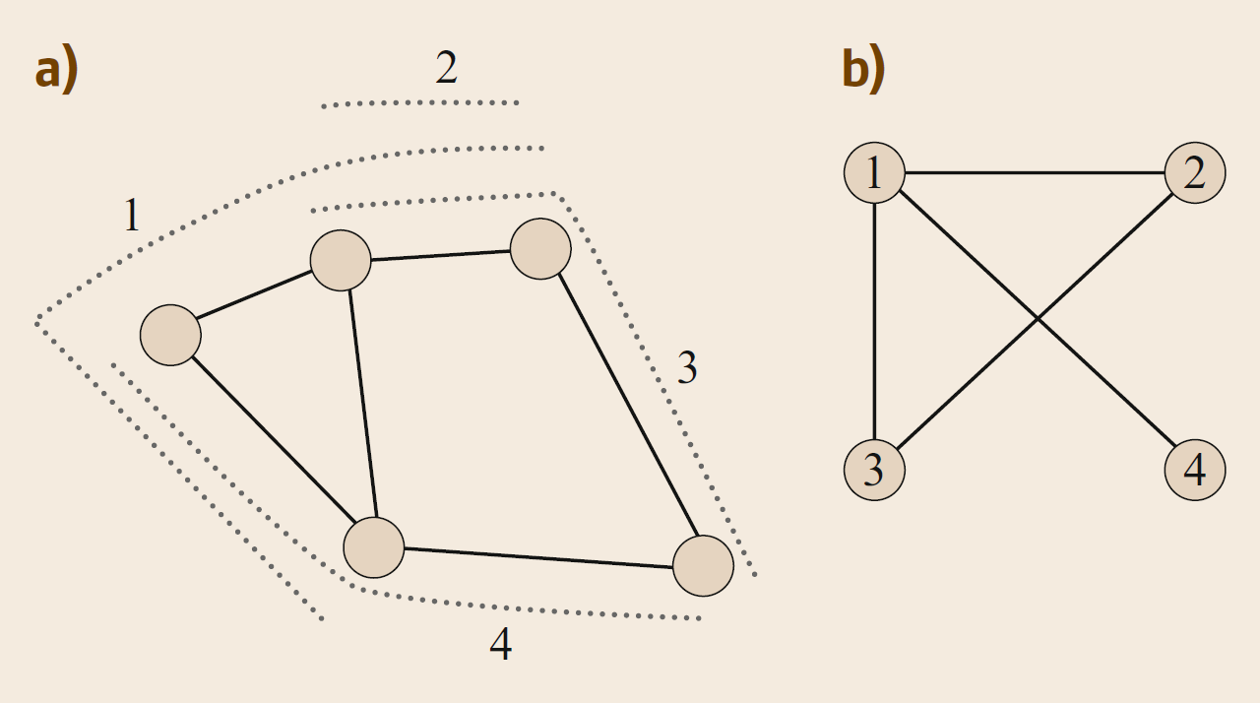
Wavelength Assignment Algorithms
WA problem as graph-coloring problem
Generating a conflict graph with lightpaths as nodes and their conflicts as links
Ordering the conflict graph nodes for coloring
Well-researched topic
Methods
First-fit
Most-used

Slide 31
Wavelength Assignment Algorithms
First-fit
Labelling and ordering available wavelengths from 1 to W
Moving over lightpaths, assigning the least-indexed available wavelength for each lightpath
No relation between wavelength indexing and wavelength position on spectrum!
Manipulations can be made in purpose to satisfy some target.
Most-used
Giving adaptive indices to wavelengths based on their current usage in network
Indexing wavelengths from most-used to least-used from lowest to highest
More computation
So, what is the motivation behind most-used?

Slide 32
RWA Schemes
One-step RWA
Solving the problems of routing and wavelength assignment together
Better results
Better in heavily-loaded networks
More complicated!
Topology pruning
Moving over wavelengths and reducing the network topology to those links with free capacity on that wavelength
Reachability graph transformation
Breaking network topology to all-optical segments

Slide 33
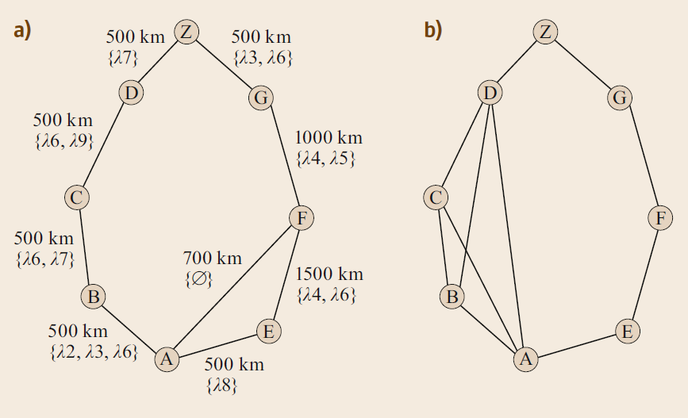
One-Step RWA; Reachability Graph Transformation
(Optical reach is 2,000km)

Slide 34
RWA Schemes (cont’d)
Flow-Based Methods
Modelling the RWA problem as ILP
Very close to optimal
Time-consuming
Using LP with solution-rounding techniques
Starting with candidates paths instead of a free-running of ILP
Cost functions offering load-balancing
Suitable for highly-loaded networks with low number of free wavelengths
ILP-Based Ring RWA
Same as ILP-based RWA, though in ring topologies
Dramatically faster due to ring structure
Scalable
Further research suggestion:
Studying ILP-Based Ring RWA in mesh networks through decomposition

Slide 35
Impairment-Aware Routing and Wavelength Assignment
RWA + physical-layer models
Adaptive link metrics
Effect of wavelength assignment on SPM, XPM and FWM
Pseudo-linear regime as the most popular assumption
Strategy 1
Worst-case
Links fully loaded
Guaranteed feasibility of later-added connections
Leading to extra regenerations
Too pessimistic!
Strategy 2
Precise calculation of impairments on time
Less regeneration
Changeable condition of old services due to the new ones

Slide 36
Worst-Case vs. Precise Impairment Calculation
When using precise calculation with no regeneration:
Reduction in blocking probability by an order of magnitude
Optical reach and precise calculation, are of less importance in metro networks.

Slide 37
Impact of Impairments on RWA
Changing the link metrics based on their spectrum
Using a modified Dijkstra algorithm to find may paths between source and destination
Choosing a path out of many using a scalar function
Machine learning
Estimating quality of transmission (QoT) for new connections
Establishing databases before
Indexing the stored paths in database based on their character
Detecting resemblance of a new connection to paths in database and using those information in RWA

Slide 38
Mixed Line-Rate Systems
Combination of line-rates of different amounts
Carrying 10Gbps and 40Gbps signals together
Detrimental effect of 10Gbps signals on 40Gbps signals due to XPM
Reasonable use of precise calculation of impairments due to escaping pessimistic design of worst-case strategy

Slide 39
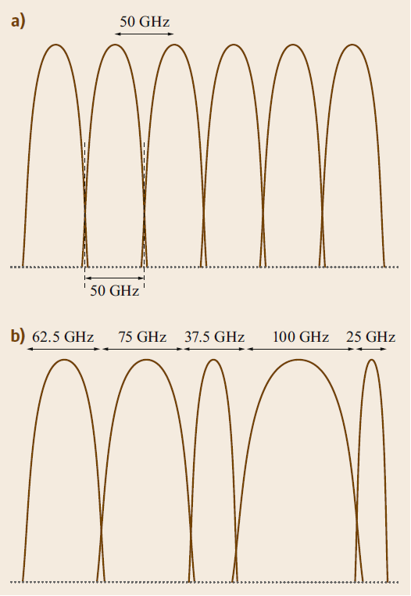
Elastic Optical Networks (EONs)
Arbitrary wavelength griding
Replacing grooming with spectrum-sliced elastic (SLICE) optical path architecture
Allocating a flexible-bandwidth wavelength to a client service
More power and cost efficient compared to grooming
EONs are networks supporting SLICE

Slide 40
EONs (cont’d)
OFDM
Carrying a signal over multiple carriers
More tolerable to fiber impairments
Software-controlled bandwidth-variable transponders (BVTs)
Handling variable-rate
Serving as multiple virtual transponders for narrow-bandwidth connections
Variable-bandwidth switches
LCoS-WSSs
The limitation of filtering technology imposes the griding not to be totally unquantized. Rather, it must provide multiples of a base bandwidth called slot.

Slide 41
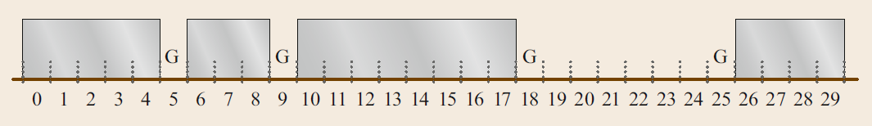
EONs (cont’d)
Ideal and aggressively pursued for future network architecture

Slide 42
RSA in EONs
Routing is the same!
Spectrum assignment
Assigning a particular set of slots to an optical channel
Continuity constraint
Same slots must be assigned in an all-optical segment of transmission
Similar to continuity in fixed-grid networks
Contiguity constraint
Slots must be assigned consecutively to a connection
New concept in EONs!
More challenging and complicated design
Multi-step RSA is more reasonable.
The alternative-path routing is favored once again.
Both link-load and fragmentation are important now.

Slide 43
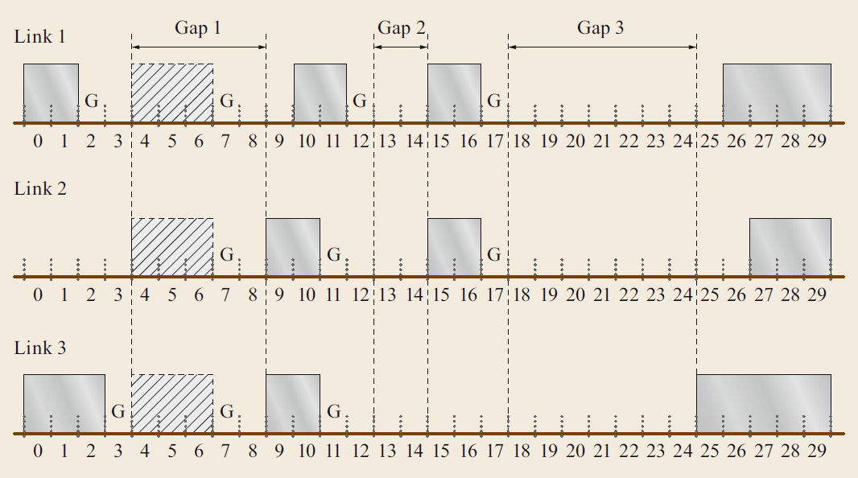
RSA in EONs (cont’d)
Spectrum assignment
Weighted graph-coloring
More weights to connection requests with more required slots
Considering contiguity
Variations to first-fit and most-used
First-last-fit
Best-fit
Exact-fit (reverting to first-fit)

Slide 44
RSA in EONs (cont’d)
ILP-based RSA
Constraints
Unique spectrum assignment on a single fiber
Continuity
Contiguity
Objective function
Minimizing the maximum number of utilized slots on all links
Minimizing the highest-numbered slot utilized on any link
Minimizing the total number of slots utilized across the network
Minimizing the amount of requested bandwidth that is blocked
Distance-adaptive RSA
Routing, modulation level and spectrum assignment (RMLSA)
Including modulation level for transmission reach maximization
Transmission degradation due to multiple modulation formats in fibers
Routing, Spectrum and Core Assignment (RSCA)
Including multi-core fibers and space-division multiplexing
Crosstalk between cores ☹

Slide 45
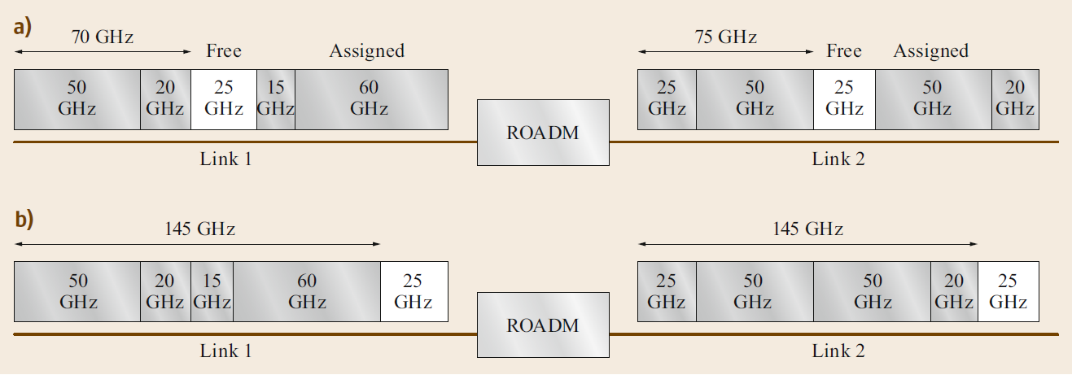
Defragmentation
Saving stranded bandwidth and displacing gaps

Slide 46
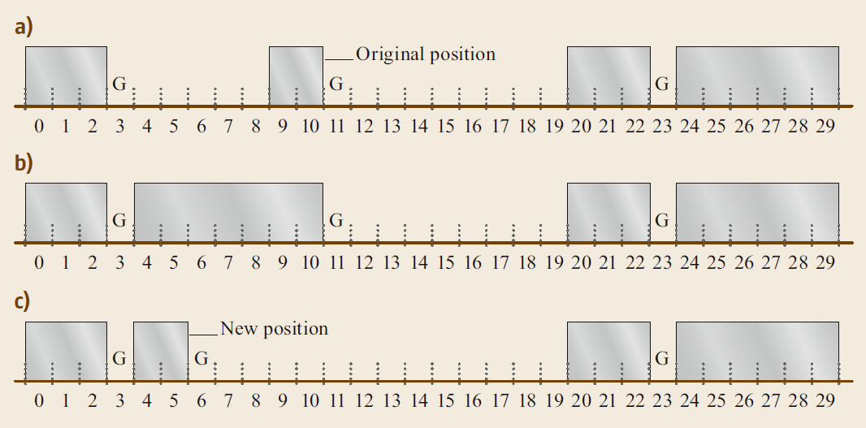
Push-Pull Defragmentation

Slide 47
Any Questions?

